Slide 1
Trento, 02 December 2020
Ph.D. Student: Chiara Nardin
chiara.nardin@unitn.it
Introduction
Performance Based Earthquake Engineering
Ph.D. Student Chiara Nardin – M.Sc., Eng. in Civil Engineering
https://github.com/kia13nn/ISPS.git

Slide 2
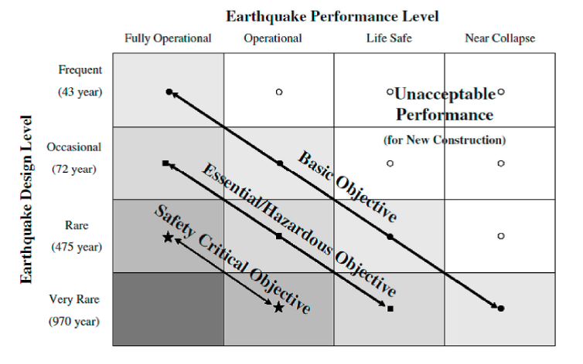
Trento, 02 December 2020
Ph.D. Student: Chiara Nardin
chiara.nardin@unitn.it
Introduction | Probabilistic Hazard Analysis | Fragility Analysis | References
PBEE: Performance Based Earthquake Engineering
Probabilistic framework for (i) assessing design, (ii) evaluation and (iii) planning of civil system.
load-and-resistence-factor design (LRFD)
performance based design (PBD):
3Ds – i.e. downtime, dollars, death
2 axes define the domain of acceptable system’s response:
System performance objectives
Seismic hazard level, w.r.t. return periods
Fig.1 – PBEE concept: seismic performance objectives vs seismic hazard level. ©Poland et al.,(1995)-Vision 2000: Performance Based Earthquake Engineering of buildings. Structural Engineers Association of California, Sacramento, CA.
Notes:
Let’s start with PBEE.
Performance-Based Earthquake Engineering (PBEE) is a probabilistic framework, which supports designers and stakeholders in assessing design, evaluation, and planning of civil systems. The utmost goal of the PBEE is to replace the classical load-and-resistance-factor design, based on evaluation of failure probabilities of single components, by developing instead a framework capable of assessing performances of a system, with respect to different decision variables such as downtime, monetary losses and fatalities.
A schematic view of the PBEE framework is given in Figure 1.
Two axes define the PBEE framework, a discrete set of system performance objectives, that includes for example fully operational, operational, life safe and near collapse, and a set (discrete or continuous) of seismic hazard level, divided according to return period or exceedance probability.
The generated domain is therefore partitioned into an acceptable and not acceptable subdomain: here, in the former, designer and stakeholders identify the desired or optimal combination between performance objectives and hazard level in order to evaluate, according to its likelihood, the monetary cost of the system.

Slide 3
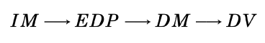
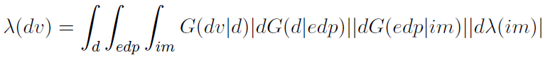

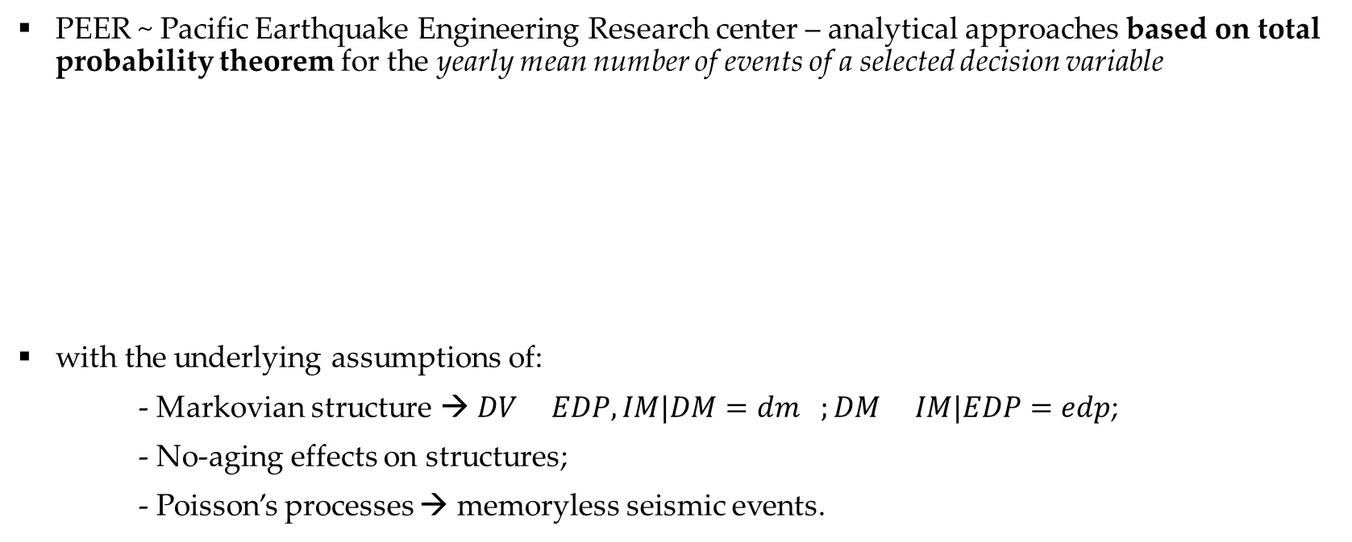
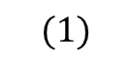
Trento, 02 December 2020
Ph.D. Student: Chiara Nardin
chiara.nardin@unitn.it
Introduction | Probabilistic Hazard Analysis | Fragility Analysis | References
The PEER-PBEE Framework
PEER ~ Pacific Earthquake Engineering Research center – analytical approaches based on total probability theorem for the yearly mean number of events of a selected decision variable
with the underlying assumptions of:
- Markovian structure → $DV EDP,IM|DM=dm ;DM IM|EDP=edp$;
- No-aging effects on structures;
- Poisson’s processes → memoryless seismic events.
$$(1)$$
Notes:
There are several alternatives and approaches to PBEE; anyway, in this class, we focus on the one provided by PEER.
The framework is simply a statement of the total probability theorem for the yearly mean number of events of a selected decision variable. You can see its analytical expression in Eq.(1): the so-called famous triple integral of PEER.
The underlying assumptions are here briefly reported and are basically: i) markovian structure, i.e. each of the conditional probabilities we are going to see can be read as statistical independent from the previous terms; ii) no aging effects are considered in the structure; iii) seismic events as a poissonian processes.

Slide 4
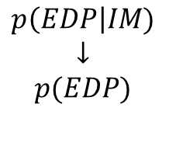
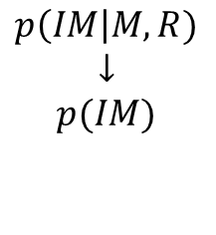
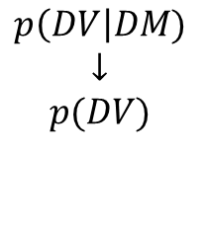
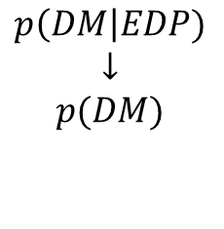
Trento, 02 December 2020
Ph.D. Student: Chiara Nardin
chiara.nardin@unitn.it
Introduction | Probabilistic Hazard Analysis | Fragility Analysis | References
The PEER-PBEE Framework
Hazard analysis
intensity measure
Loss analysis
decision variable
HAZARD
VULNERABILITY
Damage analysis
damage measure
DECISION MAKING
VULNERABILITY
Vulnerability analysis
engineering demand par.
(i) hazard analysis
(ii) fragility analysis
(iii) damage analysis
(iv) loss analysis
$$p\left(IM\right|M,R)$$
$$↓$$
$$p(IM)$$
$$p\left(EDP\right|IM)$$
$$↓$$
$$p(EDP)$$
$$p\left(DM\right|EDP)$$
$$↓$$
$$p(DM)$$
$$p\left(DV\right|DM)$$
$$↓$$
$$p(DV)$$
Notes:
However, what is more important to understand reguards the structure of this formulation.
In fact, Eq. (1) is build on four distinct stages that can be considered and evaluated alone.
The first stage/step reguards
hazard analysis which evaluates the mean annual rate of exceedance of the IM, at the facility site.
structural/fragility analysis: the engineer creates a structural model of the system, where the input is derived from the hazard analysis and the output is computed via structural analysis.
damage analysis: evaluates the relationship between EDP(i.e. the output of fragility analysis) and DM damage measure
loss analysis: (the yellow one) decision variable measures the seismic performance of the facility in terms of the stakeholder interest

Slide 5
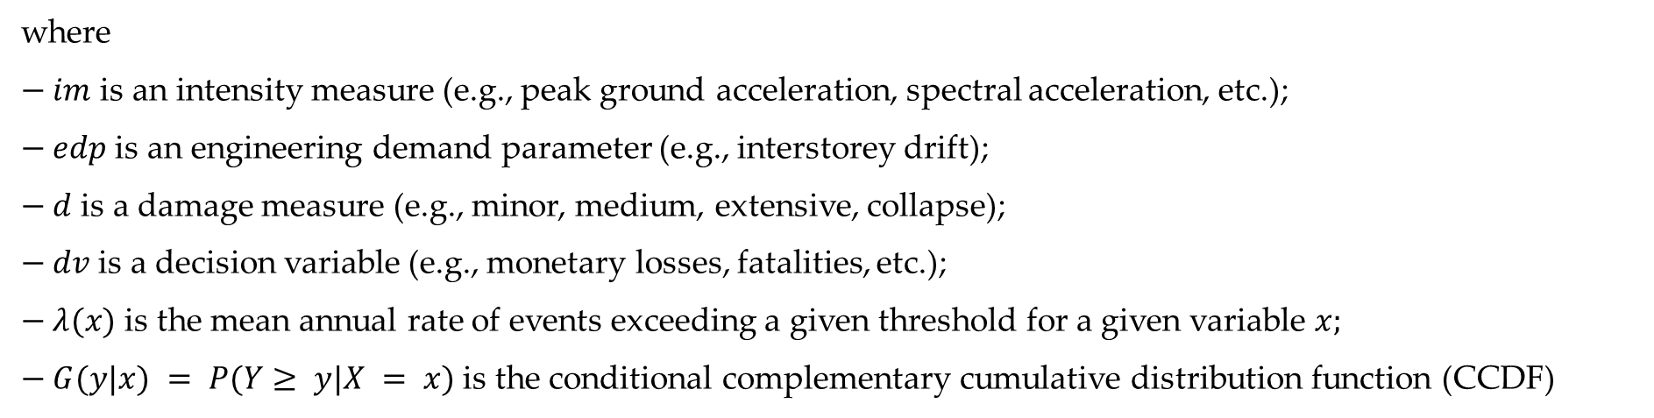
Trento, 02 December 2020
Ph.D. Student: Chiara Nardin
chiara.nardin@unitn.it
Introduction | Probabilistic Hazard Analysis | Fragility Analysis | References
The PEER-PBEE Framework
where
$− im$ is an intensity measure (e.g., peak ground acceleration, spectral acceleration, etc.);
$− edp$ is an engineering demand parameter (e.g., interstorey drift);
$− d$ is a damage measure (e.g., minor, medium, extensive, collapse);
$− dv$ is a decision variable (e.g., monetary losses, fatalities, etc.);
$− λ(x)$ is the mean annual rate of events exceeding a given threshold for a given variable $x;$
$− G(y|x) = P(Y≥ y|X = x)$ is the conditional complementary cumulative distribution function (CCDF)
Notes:
Here’s who is who. But what is again more important to understand is that Each arrow represents a model. For example, a simulation model provides the EDP for a given IM,
and a damage model provides the DM for a given EDP. Independence is assumed for quantities
that are not directly linked by a model. For instance, given the EDP, the DM are assumed to be
independent of the IM.

Slide 6
Trento, 02 December 2020
Ph.D. Student: Chiara Nardin
chiara.nardin@unitn.it
Probabilistic Hazard Analysis
Formulation and MatLab Computation
Ph.D. Student Chiara Nardin – M.Sc., Eng. in Civil Engineering
https://github.com/kia13nn/ISPS.git
Notes:
So, the first step of PBEE is SHA, that represent the basis for many earthquake design codes practices and for seismic risk analysis of civil systems. Reliable estimates of a seismic hazard are paramounts to minimize loss of life, property damage and social and economic disruption.

Slide 7
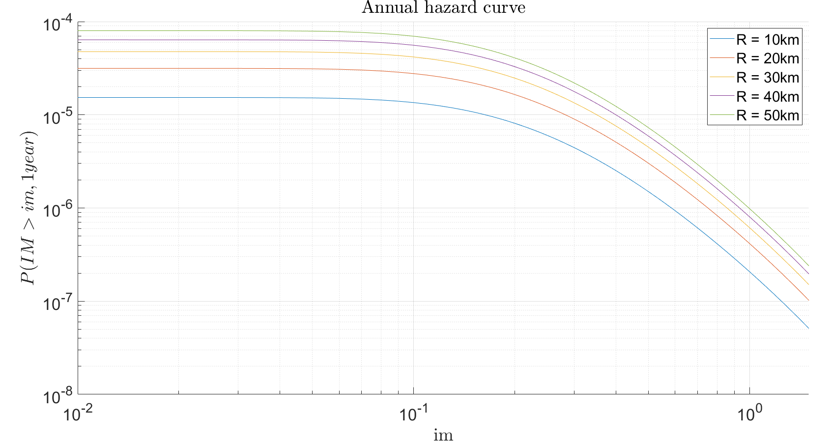
Trento, 02 December 2020
Ph.D. Student: Chiara Nardin
chiara.nardin@unitn.it
Introduction | Probabilistic Hazard Analysis | Fragility Analysis | References
Step 4: Hazard Computation
Goal and results
Through the scheme depicted in (1), compute:
the annual hazard curve for each fault;
the 50 years hazard curve for each fault;
the 475 years hazard curve for each fault
for the highlighted seismic site.
Notes:
So here are reported the solution we can obtain by running the provided code in matlab.

Slide 8
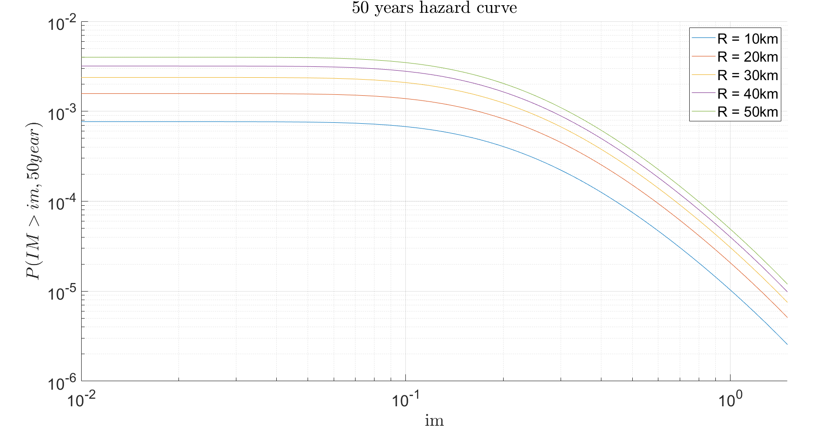
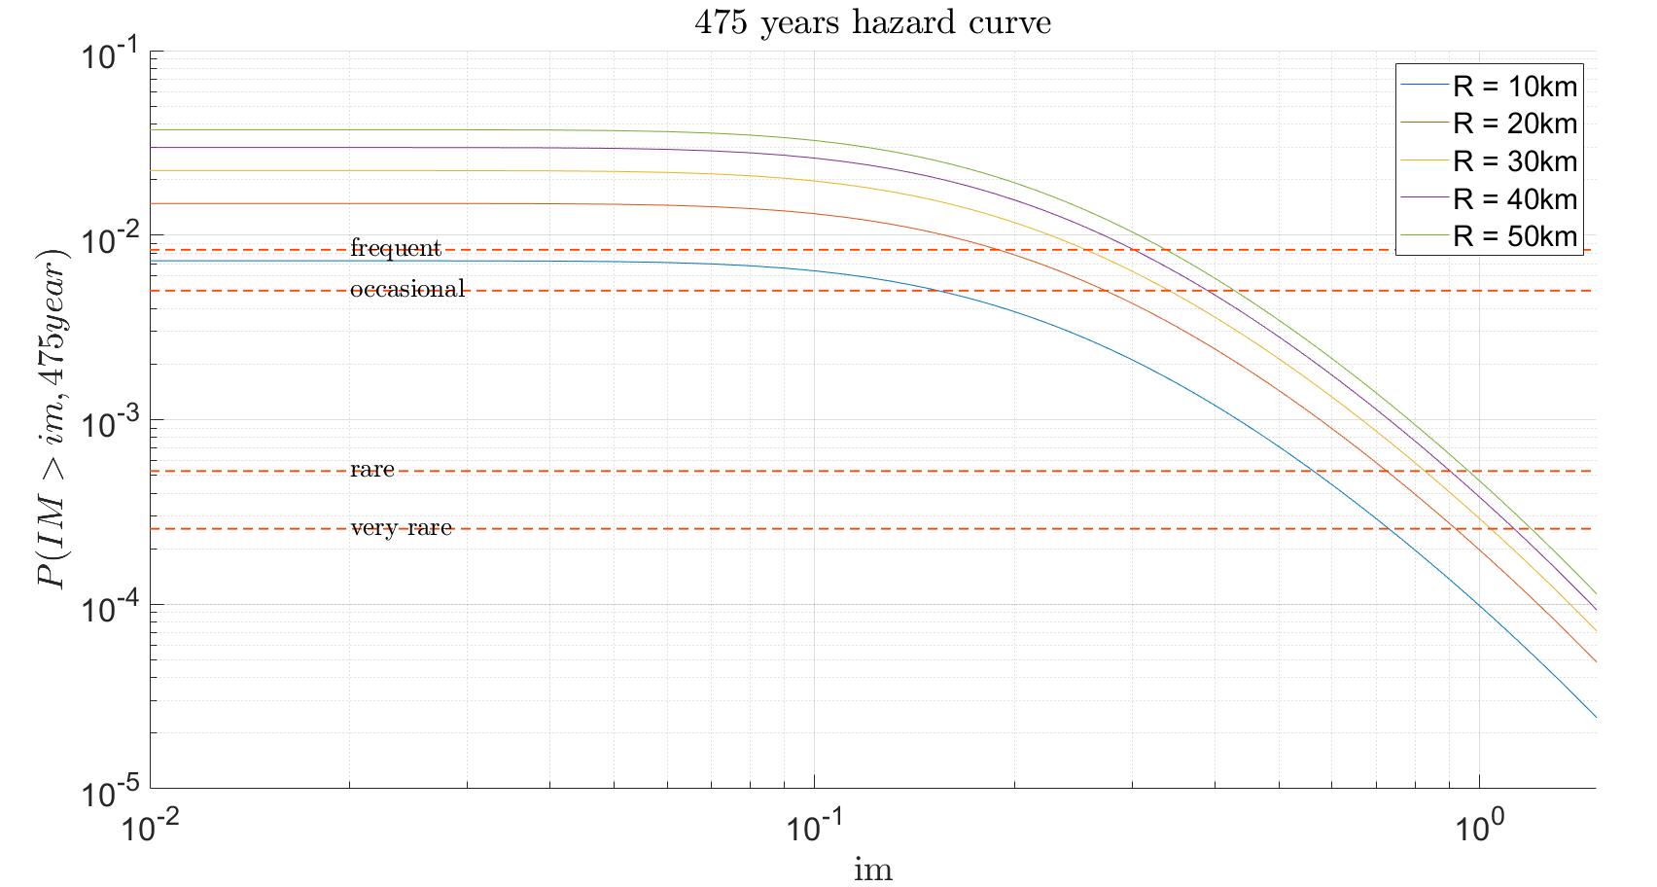
Trento, 02 December 2020
Ph.D. Student: Chiara Nardin
chiara.nardin@unitn.it
Introduction | Probabilistic Hazard Analysis | Fragility Analysis | References
Step 4: Hazard Computation
Notes:
$$λ(M>m_{min})\int_{r_{min}}^{r_{max}}{\int_{m_{min}}^{m_{max}}{P\left(IM>im \right|M=m , R=r)}} f_{R}^{\left(n\right)}\left(r\right)f_{M}^{\left(n\right)}\left(m\right)drdm$$

Slide 9
Trento, 02 December 2020
Ph.D. Student: Chiara Nardin
chiara.nardin@unitn.it
Fragility Analysis
Formulation and MatLab Computation
Ph.D. Student Chiara Nardin – M.Sc., Eng. in Civil Engineering
https://github.com/kia13nn/ISPS.git
Notes:
Welcome back. Let’s focus now on the fragility analysis.

Slide 10
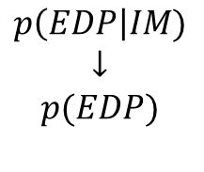
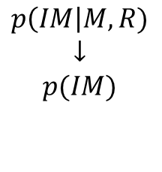
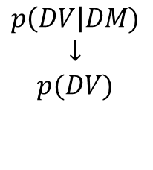
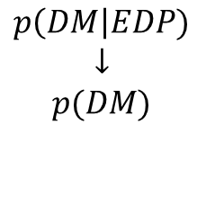
Trento, 02 December 2020
Ph.D. Student: Chiara Nardin
chiara.nardin@unitn.it
Introduction | Probabilistic Hazard Analysis | Fragility Analysis | References
Fragility Analysis
Hazard analysis
intensity measure
Loss analysis
decision variable
HAZARD
VULNERABILITY
Damage analysis
damage measure
DECISION MAKING
VULNERABILITY
Vulnerability analysis
engineering demand par.
Fragility (or Vulnerability) Analysis is the second step of the PBEE-PEER framework
Useful definitions:
seismic fragility function := the conditional probability of an event (e.g. a defined limit/damage state) given the observation of an intensity measure which describe the seismic event.
$$p\left(IM\right|M,R)$$
$$↓$$
$$p(IM)$$
$$p\left(EDP\right|IM)$$
$$↓$$
$$p(EDP)$$
$$p\left(DM\right|EDP)$$
$$↓$$
$$p(DM)$$
$$p\left(DV\right|DM)$$
$$↓$$
$$p(DV)$$
Notes:
Fragility analysis represent the next step on the PBEE framework that we have seen in the first part of the lecture.
Its definition is below reported: again, fragility is defined as the conditional probability of an event, a defined limit state, given the observation of an intensity measure which describe the seismic event.

Slide 11
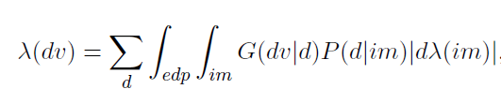
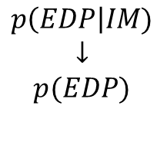
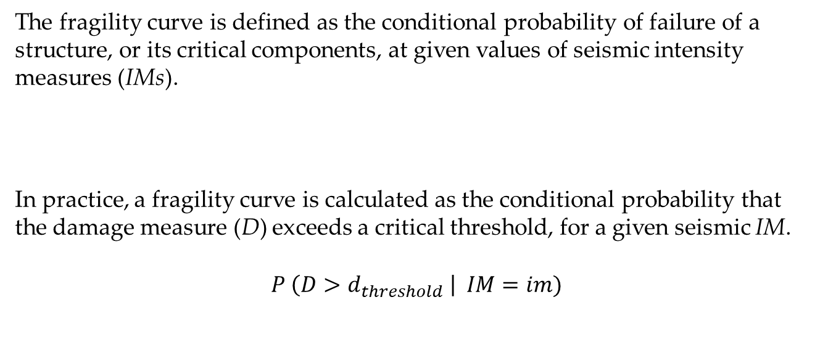
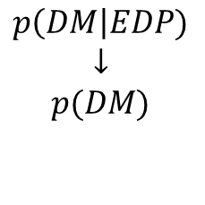
Trento, 02 December 2020
Ph.D. Student: Chiara Nardin
chiara.nardin@unitn.it
Introduction | Probabilistic Hazard Analysis | Fragility Analysis | References
Fragility Analysis
Vulnerability analysis
engineering demand par.
The fragility curve is defined as the conditional probability of failure of a structure, or its critical components, at given values of seismic intensity measures (IMs).
In practice, a fragility curve is calculated as the conditional probability that the damage measure (D) exceeds a critical threshold, for a given seismic IM.
$$P \left(D>d_{threshold} \right| IM=im)$$
VULNERABILITY
$$p\left(EDP\right|IM)$$
$$↓$$
$$p(EDP)$$
Damage analysis
damage measure
VULNERABILITY
$$p\left(DM\right|EDP)$$
$$↓$$
$$p(DM)$$
Notes:
Fragility analysis involved both vulnerability and damage analysis, since it requires the evaluation of both probability of EDPconditioned by IM and DM conditioned by EDP.
In fact, by definition, the fragility curve is defined as the conditional probability of failure of a structure or its critical component, at given values of seismic intensity.
In practice a fragility is calculated as the conditional probability tha the damage measure D exceeds a critical threshold for a given seismic IM.

Slide 12
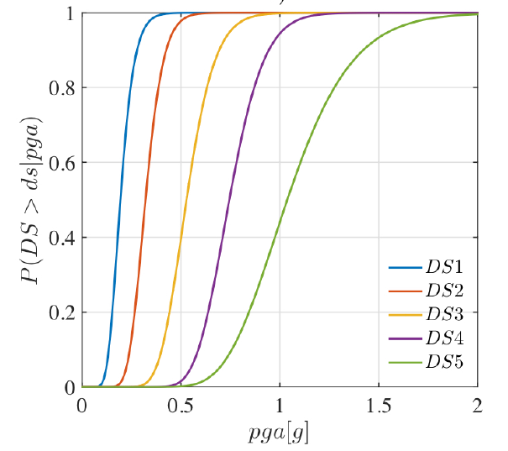
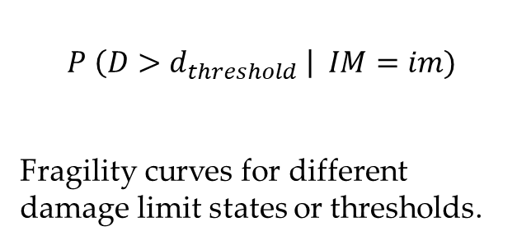
Trento, 02 December 2020
Ph.D. Student: Chiara Nardin
chiara.nardin@unitn.it
Introduction | Probabilistic Hazard Analysis | Fragility Analysis | References
Fragility Analysis
Vulnerability analysis
engineering demand par.
$$P \left(D>d_{threshold} \right| IM=im)$$
Fragility curves for different damage limit states or thresholds.
VULNERABILITY
$$p\left(EDP\right|IM)$$
$$↓$$
$$p(EDP)$$
Damage analysis
damage measure
VULNERABILITY
$$p\left(DM\right|EDP)$$
$$↓$$
$$p(DM)$$
Notes:
So, here is reported an example of fragility curves for different damage limit states, defined according to some criteria based upon the engineering demand parameters, for incresing level of pga.

Slide 13
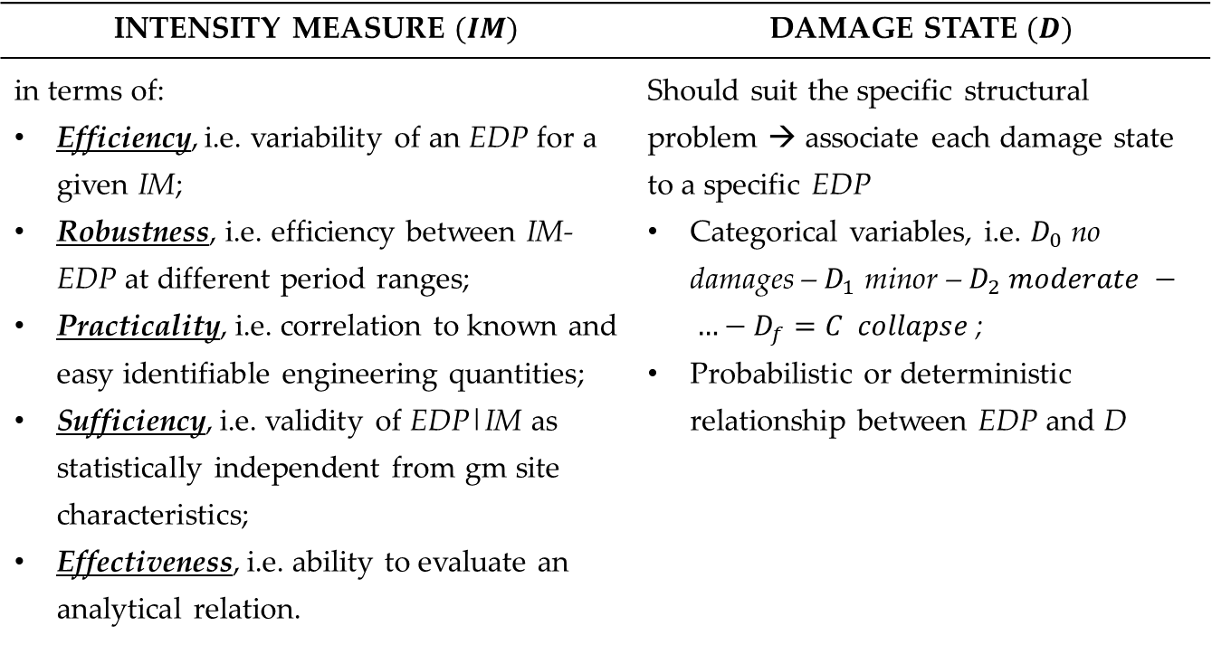
Trento, 02 December 2020
Ph.D. Student: Chiara Nardin
chiara.nardin@unitn.it
Introduction | Probabilistic Hazard Analysis | Fragility Analysis | References
Fragility Analysis: key aspects
Vulnerability analysis
engineering demand par.
INTENSITY MEASURE $(IM)$ | DAMAGE STATE $(D)$
in terms of: Efficiency, i.e. variability of an EDP for a given IM; Robustness, i.e. efficiency between IM-EDP at different period ranges; Practicality, i.e. correlation to known and easy identifiable engineering quantities; Sufficiency, i.e. validity of EDP|IM as statistically independent from gm site characteristics; Effectiveness, i.e. ability to evaluate an analytical relation. | Should suit the specific structural problem → associate each damage state to a specific EDP Categorical variables, i.e. $D_{0}$ no damages – $D_{1}$ minor – $D_{2} moderate − …−D_{f}=C collapse$; Probabilistic or deterministic relationship between EDP and D
VULNERABILITY
$$p\left(EDP\right|IM)$$
$$↓$$
$$p(EDP)$$
Damage analysis
damage measure
VULNERABILITY
$$p\left(DM\right|EDP)$$
$$↓$$
$$p(DM)$$
Notes:
We understand therefore how intensity measure and damage state definition are crucial in the formulation of fragility functions. In greater details, for the intensity measure some properties here enlisted are required: for example efficiency, robustness, practicality syffucuebct abd effectiveness.
Regarding damage state definition instead, it should suit the specific structural problem. In other terms, it is fundamental that damage state definition are based on edp that are significative for the structural problem. Generally, the damage states are de_ned with categorical variables as follow
_ D0 No damage; _ D1 Slight, minor damage; _ D2 Moderate damage;_ D3 Extensive Damage and C Collapse.
It must be said that it is also possible to de_ne continues damage states, e.g. through continuous damage indexes.

Slide 14
Trento, 02 December 2020
Ph.D. Student: Chiara Nardin
chiara.nardin@unitn.it
Introduction | Probabilistic Hazard Analysis | Fragility Analysis | References
Class of fragilities
EMPIRICAL | ANALYTICAL | EXPERT OPINION | HYBRID
by fitting a function to observational data from past earthquakes or lab tests collections pairs of level of excitation and categorical variables of damage or collapse | by defining analytical structural model and analyzing its performance under different levels of the seismic hazard static, i.e. hazard as response spectrum and push-over analysis vs dynamic, i.e. collection of gms and simulations on FEM via NLA | by polling one or more experts of the given structural asset to guess or estimate the failure probability for a given hazard level | based on combination of the different methods
Notes:
There are generally four macro-classes of fragility functions:
i Empirical. Empirical fragility are obtained by fitting a function to observational data from past earthquake events or laboratory tests. Data are usually collected as ordered pairs of level of excitation and categorical variables of damage or collapse. Usually, these methods are based on pure statistical analysis (e.g. regression models).
Analytical fragility functions are derived by de_ning an analytical, or numerical,
structural model and analyzing its performance under di_erent levels of the seismic
hazard. There are two subclasses of analytical models: static, i.e. hazard considered as response spectrum and the structural analysis performi s usualy a pushover analysis; dinamic i.e. a collection of gms and simulation via non linear analysis on fe models;
Expert opinion fragilities is created by polling one or more (independently)
experts of the given structural asset. Usually, it is asked to guess or estimate the
failure probability, or a range of failure probabilities, for a given hazard level.
Hybrid fragility functions are obtained based on a combination of the di_erent
methods.

Slide 15
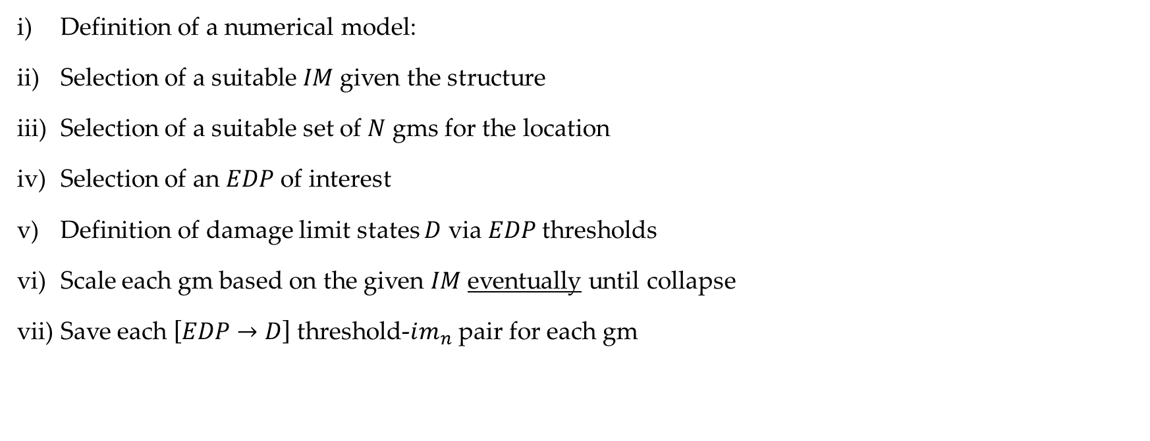
Trento, 02 December 2020
Ph.D. Student: Chiara Nardin
chiara.nardin@unitn.it
Introduction | Probabilistic Hazard Analysis | Fragility Analysis | References
Dynamic based fragility functions: steps
Definition of a numerical model:
Selection of a suitable $IM$given the structure
Selection of a suitable set of $N$ gms for the location
Selection of an $EDP$ of interest
Definition of damage limit states $D$ via $EDP$thresholds
Scale each gm based on the given $IM$eventually until collapse
Save each $\left[EDP→D\right]$ threshold-$im_{n}$ pair for each gm
Full IDA
Truncated IDA
Notes:
Incremental dynamic analysis IDA [?] is probably the most popular method to compute fragility
functions via time-history analysis. Briefly stated IDA can be summarized as follows

Slide 16
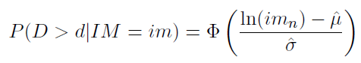
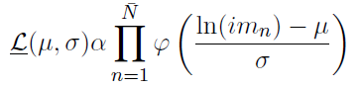
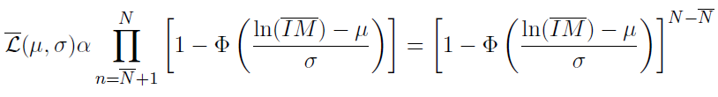
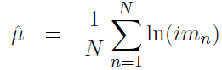
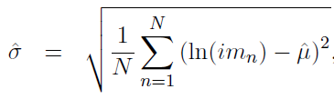
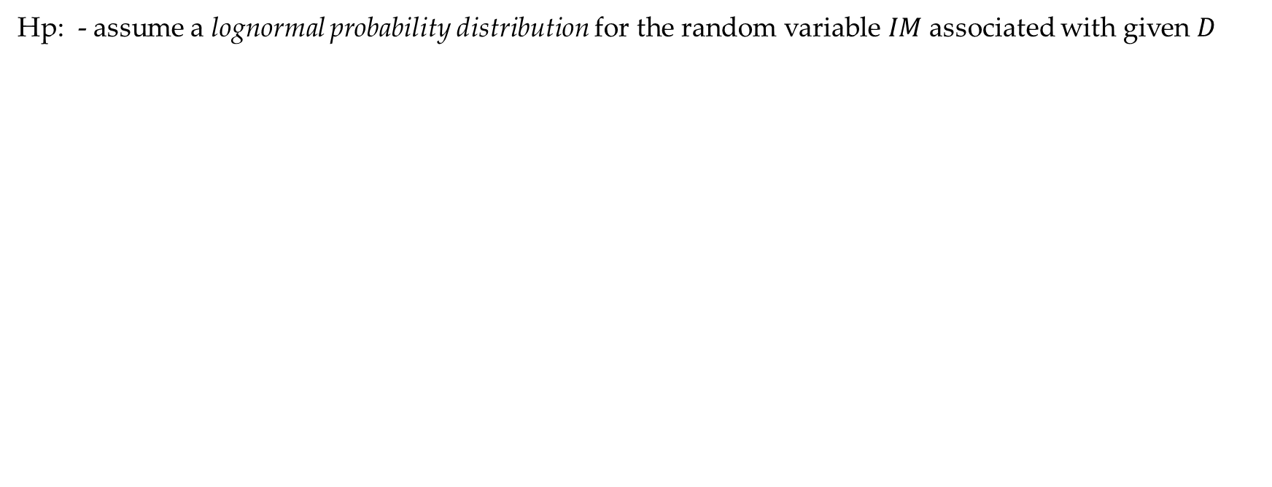
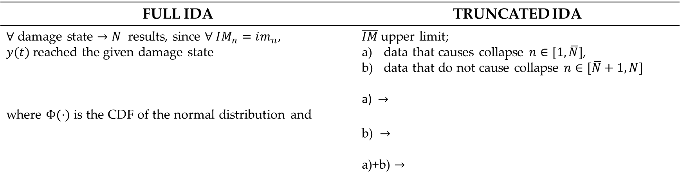
Trento, 02 December 2020
Ph.D. Student: Chiara Nardin
chiara.nardin@unitn.it
Introduction | Probabilistic Hazard Analysis | Fragility Analysis | References
Computation of fragility function
Hp: - assume a lognormal probability distribution for the random variable $IM$ associated with given $D$
FULL IDA | TRUNCATED IDA
$∀$ damage state $→N$ results, since $∀ IM_{n}=im_{n}, y(t)$reached the given damage state where $Φ(⋅)$ is the CDF of the normal distribution and | $\overline{IM}$upper limit; data that causes collapse $n∈[1,\overline{N}]$, data that do not cause collapse $n∈[\overline{N}+1,N]$ a) $→$ b) $→$ a)+b) $→$
Notes:
Then finally, perform the computation of the fragility according to different formulation in case of full or truncated IDA as reported here below.
In the first case, since analysis are scaled until collapse is reached, all collected data are from a system that have reached collapse. So the Fragility, by assuming for example a lognormal pdf for the random variable IM, can be evaluated as the CDF of the normal distribution with parameters of sigma and mu evaluated as below.
Different is the case of the truncated or even of the cloud analysis, in which there is an upper limit on the intensity measure: so not in all of the analysis the system has reached the damage desidered. Data are then collected in data that causes collapse and in data that do not cause collapse. So, for both the families the likelihood is evaluated: in the first case as the pdf of lognormal distribution, in the second case as the complement CDF of the lognormal distribution.

Slide 17
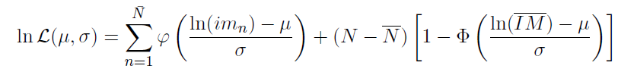
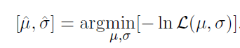
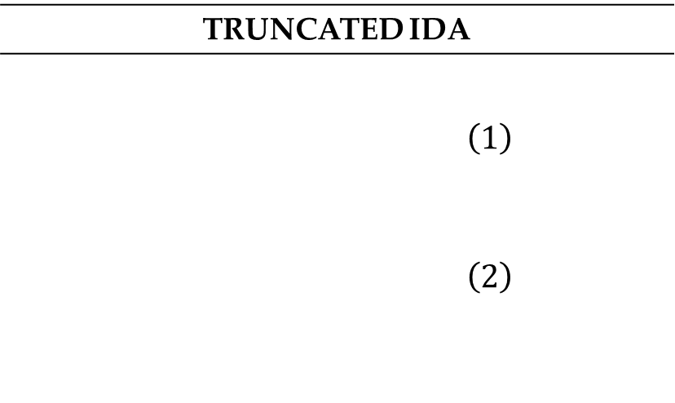
Trento, 02 December 2020
Ph.D. Student: Chiara Nardin
chiara.nardin@unitn.it
Introduction | Probabilistic Hazard Analysis | Fragility Analysis | References
Computation of fragility function
TRUNCATED IDA
$$\left(1\right)$$ $$\left(2\right)$$
The likelihood for the entire set of data
And the log likelihood
Estimation of parameters by optimization

Slide 18
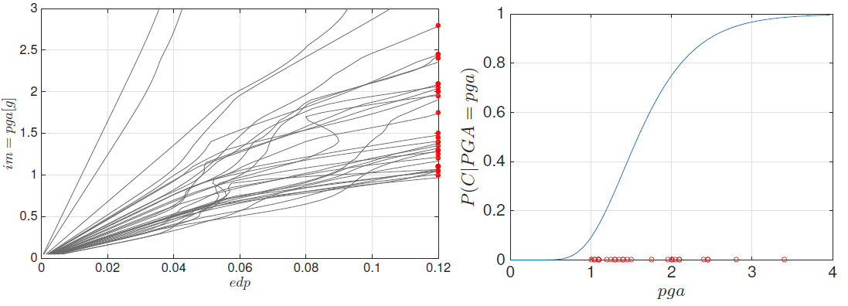
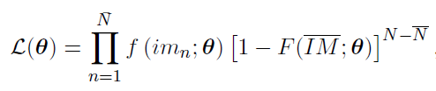
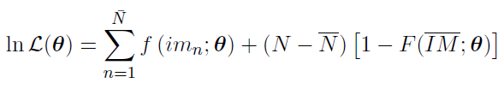
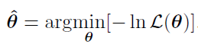
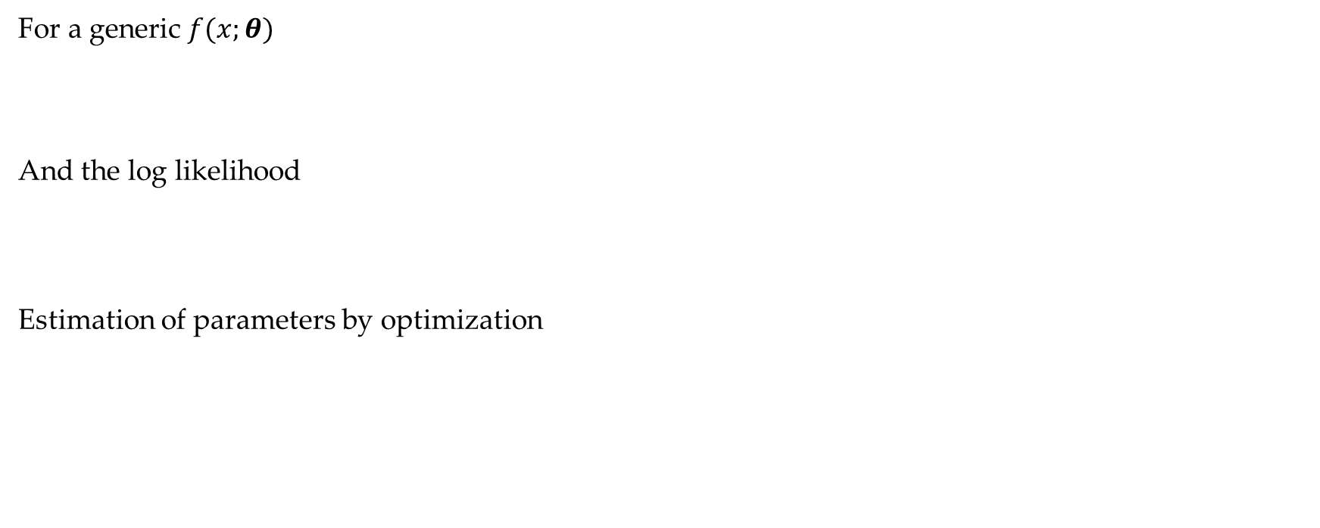
Trento, 02 December 2020
Ph.D. Student: Chiara Nardin
chiara.nardin@unitn.it
Introduction | Probabilistic Hazard Analysis | Fragility Analysis | References
Computation of fragility function
For a generic $f(x;θ)$
And the log likelihood
Estimation of parameters by optimization
Fig.1 – Fragility function computed via IDA, see Broccardo, M. (2018) Probabilistic seismic risk analysis for civil systems, Lecture Notes.
Notes:
More in generally, we can compute fragility in this manner by define a generic pdf: this is an equivalent way of describe the problem by not limiting our description just to a lognormal distribution.

Slide 19
Trento, 02 December 2020
Ph.D. Student: Chiara Nardin
chiara.nardin@unitn.it
Fragility Analysis
Formulation and MatLab Computation
Ph.D. Student Chiara Nardin – M.Sc., Eng. in Civil Engineering
https://github.com/kia13nn/ISPS.git
Notes:
So, let’s see now an application study and some code implemented inside matlab for fragility evaluations.

Slide 20
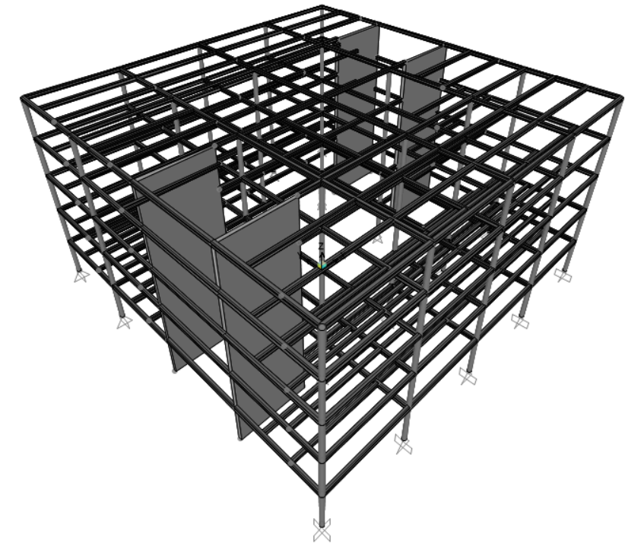
Trento, 02 December 2020
Ph.D. Student: Chiara Nardin
chiara.nardin@unitn.it
Introduction | Probabilistic Hazard Analysis | Fragility Analysis | References
Goal: to perform fragility analysis
Given the provided set of ground motions, perform a classical and truncated incremental dynamic analysis (IDA) and determine fragility curves for:
ATTEL – moment resistant frame (MRF);
ATTEL – braced frame (BF)
by considering both
Linear elastic behaviour
Bouc – Wen model for hysteresis
3D model of the case study ATTEL – SERA project.
Notes:
The objective is to perform fragility analysis for this case study, later on described.
So, given a provided set of ground motions, our goal is to perform both classical and truncated IDA and determine fragility curves for both the structure ATTEL along the MRF direction and the BF direction. Moreover, the implemented model consider the possibility to adopt a bouc wen model to take into account also hyesteresis.

Slide 21
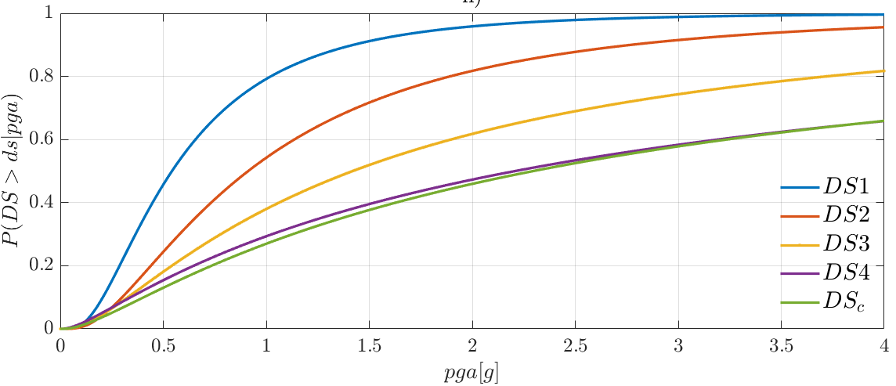
Trento, 02 December 2020
Ph.D. Student: Chiara Nardin
chiara.nardin@unitn.it
Introduction | Probabilistic Hazard Analysis | Fragility Analysis | References
Main steps:
Definition of the numerical model
Input and IM selection
Definition of damage limit states and reference EDP
Performing non-linear time histories analysis (IDA, truncated IDA, cloud, MSA …)
Collecting results pairs and computing fragility
3D model of the case study ATTEL – SERA project.
Notes:
So the main steps in which also codes are organized are here summarizes:
A definition of the numerical model of the structure is required;
Input and proper IM is needed, and this as we will see is obtained by scatter plot and data exploration of the dataset of gms;
Definition of proper limit states and informative edp for the examinated system
Non linear time histories analysis to be performed, via IDA or truncated IDA or several other methods;
Collecting EDP – IM and computing fragilities

Slide 22
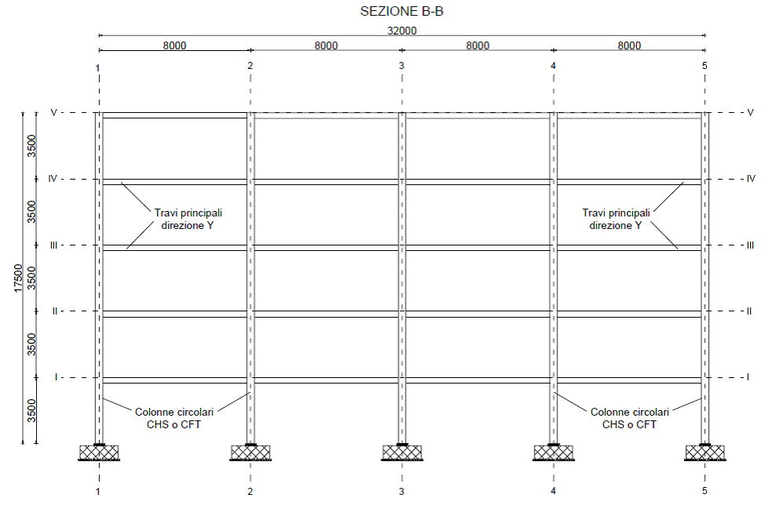
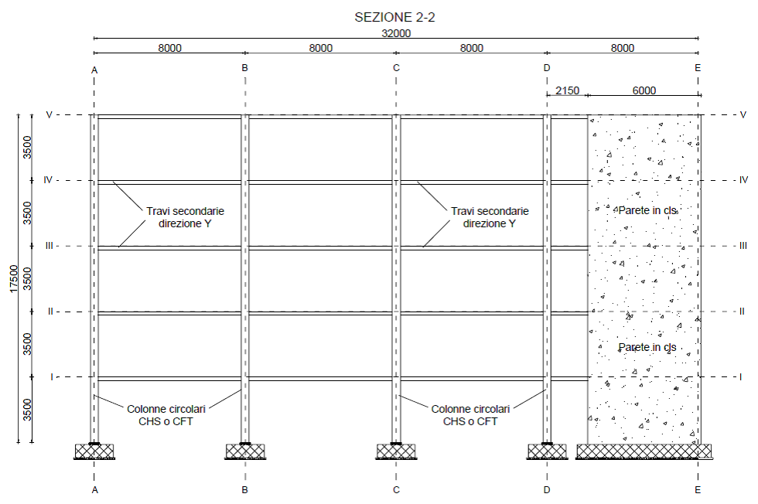
Trento, 02 December 2020
Ph.D. Student: Chiara Nardin
chiara.nardin@unitn.it
Introduction | Probabilistic Hazard Analysis | Fragility Analysis | References
Step 1: the case study ATTEL⁽¹⁾
^{[1]}BURSI, PUCINOTTI, TONDINI, ZANON, Tests and model calibration of high strength steel tubular beam-to-column and column-base composite joints for moment-resisting structures, Earthquake Engineering and Structural Dynamics, (2015).
T₁ = 2.79 s
T₁ = 0.46 s
3D model of the case study ATTEL – SERA project.
Main sections of the moment resistent frame and the braced one.
Notes:
Let’s start with the first step: the FE model of ATTEL, for more information in the references you will find a link to some more material about it. It consists of a multi level steel frame structure: in particular along one direction the structural system consists of a moment resisting steel frame and has a period of 2.79 s, so very flexible. Along the orthogonal one, the structural system has concrete shear walls leading to a principal period along this direction of almost 0.46 s. Here just some reference sections are reported.

Slide 23
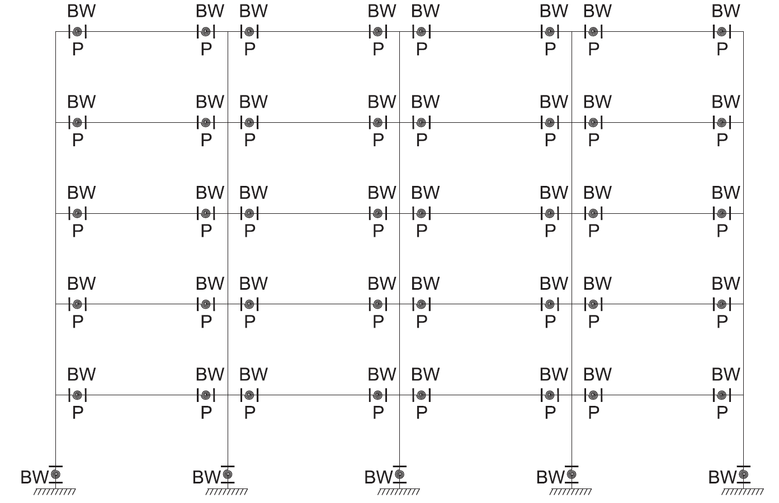
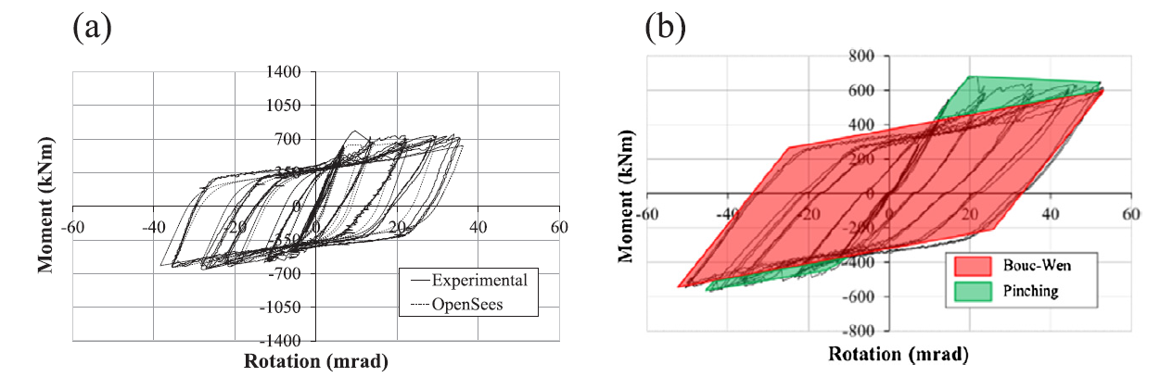
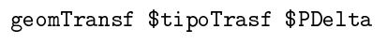
Trento, 02 December 2020
Ph.D. Student: Chiara Nardin
chiara.nardin@unitn.it
Introduction | Probabilistic Hazard Analysis | Fragility Analysis | References
Designed according to EC8 and modelled in OS:
beam and column elements with linear elastic behavior
mechanical nonlinearities
geometric nonlinearities
Model of the structure in OpenSees.
Notes:
The structural system, designed according to EC8 seismic provisions, have been implemented firstly in a high fidelity model into OpenSees. By considering beam and column elements with linear elastic behaviour, but also taking into account mechanical non-linearities inside plastic hinges through a bouc-wen modified model. Also second order effects like P-Delta have been considered in the analysis.

Slide 24
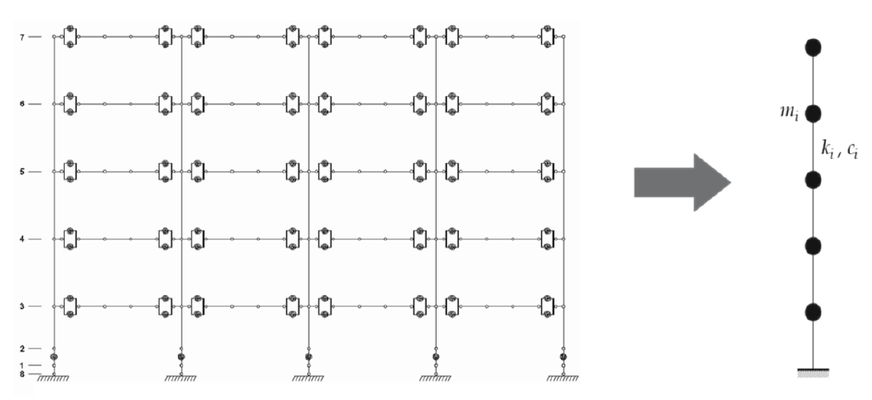
Trento, 02 December 2020
Ph.D. Student: Chiara Nardin
chiara.nardin@unitn.it
Introduction | Probabilistic Hazard Analysis | Fragility Analysis | References
to reduce computational burden
to reduce required simulation times
High number of analysis
for seismic simulations
Calibration oriented to correspondence of:
main periods
modes of vibrating
dissipative behavior
high fidelity model in OpenSees - OS
simplified model MDOF in MATLAB ® - ML
Notes:
Since the high number of simulation and analysis requests, we decided to adopt a simplified model in order to reduce the computational burden and time requests. A calibration procedure oriented to correspondence of main periods, modes of vibrating have been carried out resulting in a reduced MDOF model, reported inside the codes for matlab.

Slide 25
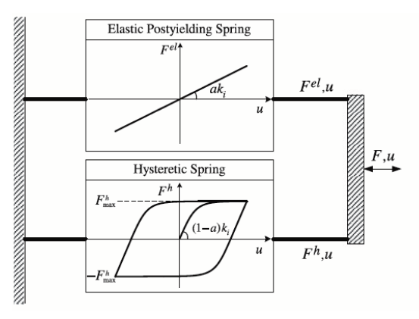
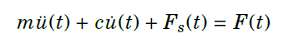



Trento, 02 December 2020
Ph.D. Student: Chiara Nardin
chiara.nardin@unitn.it
Introduction | Probabilistic Hazard Analysis | Fragility Analysis | References
Hysteretic model of Bouc Wen
Hysteretic model of Bouc Wen.
Formulation of the problem and examples of hysteretic cycles.
Notes:
A special attention was dedicated to modeling the hysteretic behaviour through a bouc wen model here very briefly reported. Some documentation about it is reported in the references. Just a mention, the bouc-wen model essentially consists in a first-order non-linear differential equation that relates the input displacement to the output restoring force in a hysteretic way. By choosing a set of parameters appropriately, it is possible to accommodate the response of the model to the real hysteresis loops

Slide 26



Trento, 02 December 2020
Ph.D. Student: Chiara Nardin
chiara.nardin@unitn.it
Introduction | Probabilistic Hazard Analysis | Fragility Analysis | References
Step 2: input and IM selection
Dataset NGA-WEST 2
206 ground motions
crustal earthquakes
M_{w} > 6
R_{rup} > 10 km
V_{s30} > 600 m/s
fault mechanism
reverse REV
strike slip SS
main features
IMs investigated
PGA [g]
PGV [cm/s]
PGD [cm]
Sa (T₁) [g rad²]
Sv (T₁) [cm rad/s]
Sd (T₁) [cm]
PSa (T₁) [g rad²]
PSv (T₁) [cm rad/s]
Notes:
Once the structural model is defined, we need to properly prepare the seismic input. Here we have choosen a dataset from the NGA-west 2 that includes 206 ground motions.
The main features of this dataset are here summarized: first of all, the records are all from crustal earthquakes with magnitude greater than 6 and a distance from site-to-source greater than 10 km, in order to avoid near faults events or near field scenarios, shear wave velocity greater than 600 m/s. This domain of gms is then partitioned according to the fault mechanism: that could be reverse fault or strike slip.
The whole ensamble was then investigated considering different possible intensity measures here enlisted.

Slide 27



Trento, 02 December 2020
Ph.D. Student: Chiara Nardin
chiara.nardin@unitn.it
Introduction | Probabilistic Hazard Analysis | Fragility Analysis | References
Data exploration of recorded gms
Scatter plot and statistic tools to evaluate proper IM
Step 2: input and IM selection
Acceleration, velocity and displacement response spectra with mean value, 10^{-th} and 90^{-th} quantile.
Scatter plot for correlation.
Notes:
So we checked through time histories acceleration, velocity and displaments and plots of spectra before referring to scatter plot and statistical tools to find out the optimal IM capable to relationate with EDP of our considered structure.

Slide 28
Trento, 02 December 2020
Ph.D. Student: Chiara Nardin
chiara.nardin@unitn.it
Introduction | Probabilistic Hazard Analysis | Fragility Analysis | References
Step 2: input and IM selection
Codes:
%% Ground motions
Ground_motions = load('accelrot_cellarray.mat');
%
NN = [1, 2, 3, 4, 5, 6, 7, 8, 9, 10, 11, 12, 13, 14, 16, 17, 19, 21, 23, 24,...
25, 26, 28, 29, 30, 31, 32, 33, 34, 36, 37]; % number ID of the SS ground motions
DT = [0.01 , 0.01 , 0.005, 0.005, 0.005, 0.005, 0.02 , 0.02, 0.02, 0.01,...
0.01 , 0.01 , 0.02 , 0.02 , 0.02 , 0.02 , 0.02 , 0.02, 0.01, 0.01,...
0.005, 0.005, 0.005, 0.005, 0.02 , 0.005, 0.005, 0.01, 0.01, 0.01,...
0.01 , 0.005, 0.005, 0.02 , 0.005, 0.01 , 0.01]; % integration time step
Notes:
In this section of the code you see the selection of the input. Given the dataset, in our tutorial we run simulations with gms having a strike-slip fault mechanism.

Slide 29



Trento, 02 December 2020
Ph.D. Student: Chiara Nardin
chiara.nardin@unitn.it
Introduction | Probabilistic Hazard Analysis | Fragility Analysis | References
Step 3: Definition of damage limit states and reference EDP
MRF
BF
Document FEMA 356 - Prestandard and Commentary for the Seismic Rehabilitation of Buildings; Table C1-3 - Structural Performance Levels and Damage.
Notes:
Next step is about the definition of damage limit states as function of EDP for the analysed system. As you can see here reported there are some limit states function of the interstorey drift for both MRF and BF configuration, according to the FEMA 356 standards.

Slide 30
Trento, 02 December 2020
Ph.D. Student: Chiara Nardin
chiara.nardin@unitn.it
Introduction | Probabilistic Hazard Analysis | Fragility Analysis | References
Step 3: Definition of damage limit states and reference EDP
Codes:
%% MDOF Properties
% Choose between the structural system
MDOF_properties_BW_MRF
MDOF_properties_BW_BF
% and between linear or hysteretic behaviour
%% Structural behaviour
System_type = ‘le’; % ‘bw’
% bw = bouc-wen
% le = linear elastic
…
%% Limit States
LS = [0.50 0.75 1 2 3]*4/100;
for ls_i = 1:numel(LS)
ls_val = LS(ls_i)
Main_IDA_o_t
ls_i = ls_i + 1;
end
Notes:
So, in the codes we report and set all of these information: first we have to choose the structural system onto which we would like to perform the analysis, then we have to choose if we want to consider the hysteretic behaviour, that for sake of simplicity has already been calibrated in the model and provided parameters, and finally to define the limit states before of performing our simulations.

Slide 31
Trento, 02 December 2020
Ph.D. Student: Chiara Nardin
chiara.nardin@unitn.it
Introduction | Probabilistic Hazard Analysis | Fragility Analysis | References
Step 4: Performing non-linear time histories analysis
Codes:
%% Initial condition
Mat.dFe=zeros(Mat.NDOF,numel(a_g_norm)); % Preallocation for the load for the time series
a_g = a_g_norm*scale; % Scaled ground motion
Mat.Fe=Mat.M*Mat.r'*a_g'*g;
%% Computation response
[HistVarBw]=ResponceMDF_Bw(Mat);
edp = max(abs(HistVarBw.eps(1,:)));
EDP(i) = edp; %store the EDP for each time history analysis
SCALE(i) = scale; %store the scale factor for each time history analysis…
Notes:
Here is reported the core of the analysis: the definition of the time history to assign to the structure and the computation response.

Slide 32

Trento, 02 December 2020
Ph.D. Student: Chiara Nardin
chiara.nardin@unitn.it
Introduction | Probabilistic Hazard Analysis | Fragility Analysis | References
Step 5: Computing fragilities
Codes:
%% Untruncated IDA
[parmhat,parmci] = lognfit(IM_t_c ,0.01);
mu_IDA = parmhat(1);
sigma_IDA = parmhat(2);
%% Truncated IDA
IM_max = 2.2;
IM_trunc = IM_t_c(IM_t_c < IM_max); % take only the results with IM < IM_max
eq_over = sum(IM_t_c >= IM_max); % number of analyses reached IM_max without collapsing
% Maximum likelihood fit, using equation (1) and (2) of previously slides
[mu_IDA_t, sigma_IDA_t ] = truncated_ida(IM_trunc, IM_max, eq_over);

Slide 33

Trento, 02 December 2020
Ph.D. Student: Chiara Nardin
chiara.nardin@unitn.it
Introduction | Probabilistic Hazard Analysis | Fragility Analysis | References
Step 5: Computing fragilities - Results
Notes:
Finally I’ve plotted here the results of fragility computation for both MRF and BF system configuration considering hysteretic behaviour. Just one quick observation before shifting to codes, for the MRF, since it is very flexible, we need severe PGA in order to see high probability of collapse; instead for the BF we reached collapse for lower values.

Slide 34

Trento, 02 December 2020
Ph.D. Student: Chiara Nardin
chiara.nardin@unitn.it
Introduction | Probabilistic Hazard Analysis | Fragility Analysis | References
Step 5: Computing fragilities - Results
Notes:
Finally I’ve plotted here the results of fragility computation for both MRF and BF system configuration considering hysteretic behaviour. Just one quick observation before shifting to codes, for the MRF, since it is very flexible, we need severe PGA in order to see high probability of collapse; instead for the BF we reached collapse for lower values.

Slide 35
Trento, 02 December 2020
Ph.D. Student: Chiara Nardin
chiara.nardin@unitn.it
References
Ph.D. Student Chiara Nardin – M.Sc., Eng. in Civil Engineering
https://github.com/kia13nn/ISPS.git

Slide 36
Trento, 02 December 2020
Ph.D. Student: Chiara Nardin
chiara.nardin@unitn.it
Introduction | Probabilistic Hazard Analysis | Fragility Analysis | References
References:
Baker J. W. (2008). An Introduction to Probabilistic Seismic Hazard Analysis (PSHA), White Paper, Version 1.3, 72 pp.
Kramer, S.L. (1996) Geotechnical earthquake engineering. Prentice Hall, Upper Saddle River, N.J.
Wells, D.L. and Coppersmith, K.J. (1994) New empirical relationships among magnitude, rupture length, rupture width, rupture area, and surface displacement. Bull. Seism. Soc. Am., 84, 974-1002.
Cornell, C.A. (1968). Engineering seismic risk analysis, Bull. Seism. Soc. Am., 58, 1583-1606.
Broccardo, M. (2018) Probabilistic seismic risk analysis for civil systems, Lecture Notes
Stucchi M., Meletti C., Montaldo V., Akinci A., Faccioli E., Gasperini P., Malagnini L., Valensise G. (2004). Pericolosità sismica di riferimento per il territorio nazionale MPS04. Istituto Nazionale di Geofisica e Vulcanologia (INGV). https://doi.org/10.13127/sh/mps04/agKramer, S.L. (1996) Geotechnical earthquake engineering. Prentice Hall, Upper Saddle River, N.J.
http://zonesismiche.mi.ingv.it/ → Italian database

Slide 37
Trento, 02 December 2020
Ph.D. Student: Chiara Nardin
chiara.nardin@unitn.it
Introduction | Probabilistic Hazard Analysis | Fragility Analysis | References
References:
Mackie, K & Stojadinovic, Bozidar. (2003). Seismic Demands for Performance-Based Design of Bridges.
Bursi, Pucinotti, Tondini, Zanon, Tests and model calibration of high strength steel tubular beam-to-column and column-base composite joints for moment-resisting structures, Earthquake Engineering and Structural Dynamics, (2015).
Broccardo, M. (2018) Probabilistic seismic risk analysis for civil systems, Lecture Notes
Charalampakis, A. & Koumousis,V. (2010). Parameters of Bouc–Wen Model Revisited, Applied Mechanics.
Haukaas, T. & Der Kiureghian, A. (2004). Finite Element Reliability and Sensitivity Methods for Performance-Based Earthquake Engineering, tech. rep., PEER - Pacific Earthquake Engineering Research Center.

Slide 38
Trento, 02 December 2020
Ph.D. Student: Chiara Nardin
chiara.nardin@unitn.it
Thanks for the attention!
Ph.D. Student Chiara Nardin – M.Sc., Eng. in Civil Engineering
https://github.com/kia13nn/ISPS.git

